Slide 1



Lightning Talk
with
Jennifer Garcia Bashaw
Department of Christian Studies

Slide 2
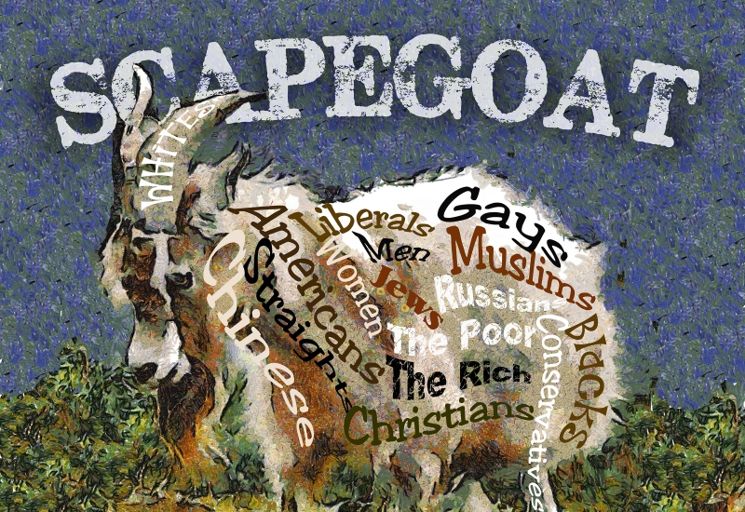
Introduction to Scapegoats
René Girard: acquisitive mimesis, mimetic violence, and religion (law, ritual, myth)
Characteristics and circumstances of scapegoats throughout history
The Gospels and Jesus, the scapegoat to end all scapegoats
Jesus’s ministry
Contemporary Scapegoating
“Scapegoat”
by: Jerry Bacik, Tarpon Springs, Florida

Slide 3





Researching Girard and His Theory

Slide 4





Biblical Studies Research
Exegetical Work from the Bible
Bible Commentaries
Original language tools
Journal Articles

Slide 5

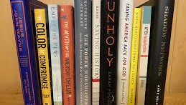


Research on Church History, Social Issues, and Current Events
Scapegoating in Church History
Women in Church History and Contemporary Society
Effects of COVID on vulnerable populations
Racism in American History
Xenophobia in Society
The Prosperity Gospel (Health and Wealth Gospel)

Slide 6
Questions?

